Slide 1


Multidimensional data analysis
Joe Donovan
MPI of Neurobiology

Slide 2
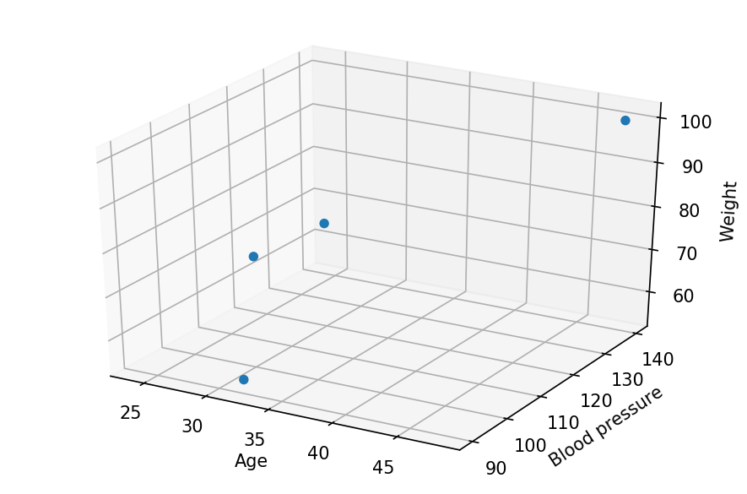
Most data is multidimensional
Multi-factor measurements
E.g. patient data – age, blood pressure, pulse
Age | Blood pressure | Weight
24 | 120 | 65
48 | 140 | 100
27 | 130 | 70
32 | 90 | 55
=

Slide 3
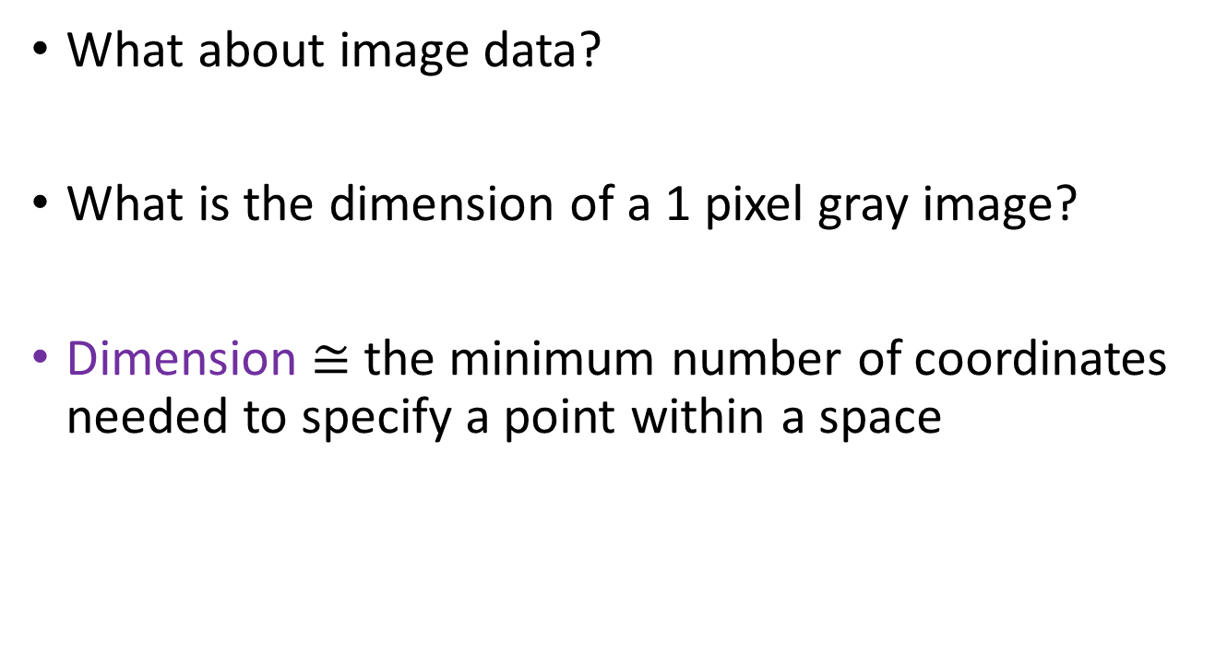
Most data is multidimensional
What about image data?
What is the dimension of a 1 pixel gray image?
Dimension $≅$ the minimum number of coordinates needed to specify a point within a space
Notes:
Image details

Slide 4
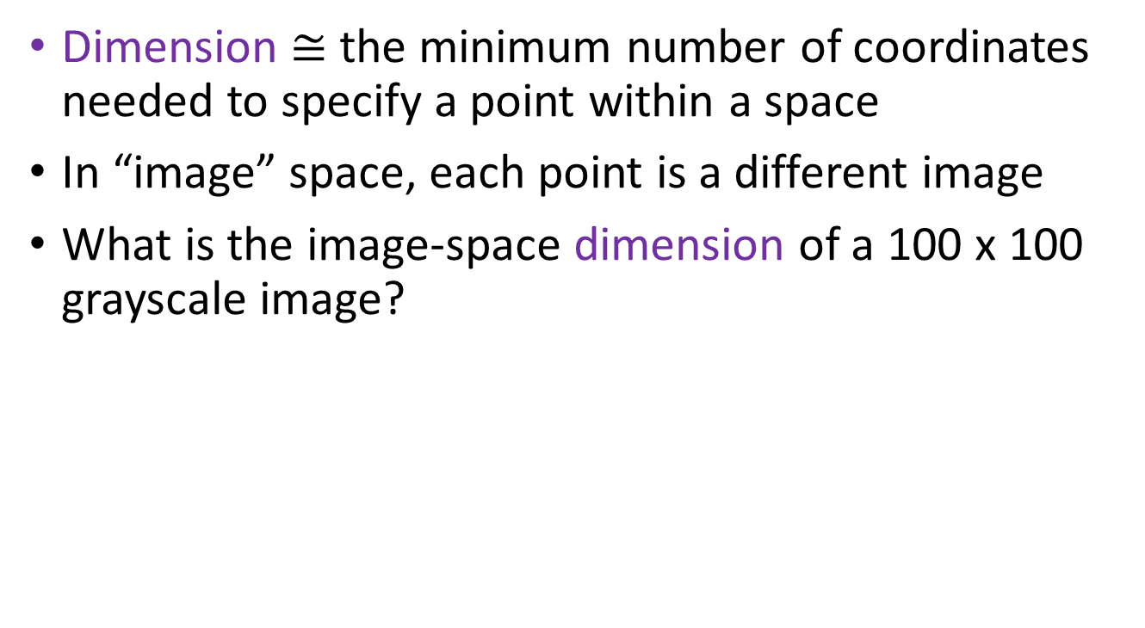
Most data is multidimensional
Dimension $≅$ the minimum number of coordinates needed to specify a point within a space
In “image” space, each point is a different image
What is the image-space dimension of a 100 x 100 grayscale image?
10,000 dimensions
Notes:
Image details

Slide 5
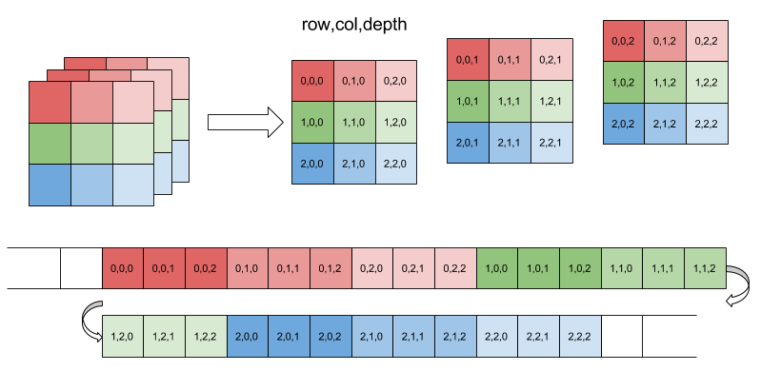
Numpy n-dimensional arrays
row
Data
col
Eli Bendersky
depth
Data is ‘wrapped’, in row major / C order
Memory
Eli Bendersky
Notes:
https://eli.thegreenplace.net/2015/memory-layout-of-multi-dimensional-arrays
Efficiency of access – striding, but still slower 10X+

Slide 6
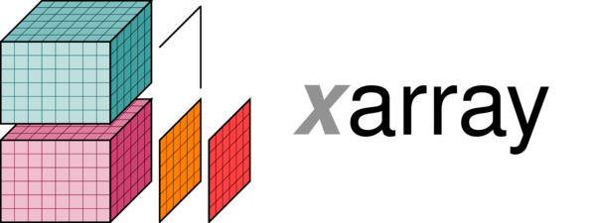
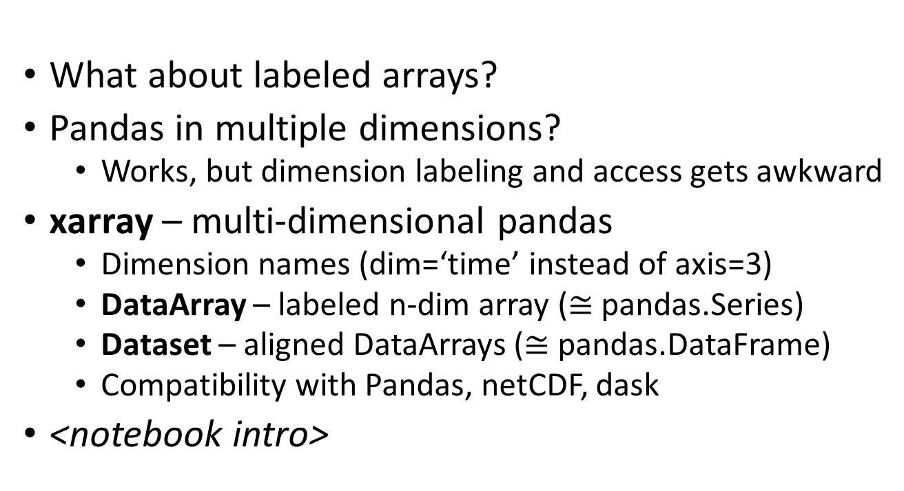
What about labeled arrays?
Pandas in multiple dimensions?
Works, but dimension labeling and access gets awkward
xarray – multi-dimensional pandas
Dimension names (dim=‘time’ instead of axis=3)
DataArray – labeled n-dim array ($≅$ pandas.Series)
Dataset – aligned DataArrays ($≅$ pandas.DataFrame)
Compatibility with Pandas, netCDF, dask
<notebook intro>

Slide 7
Challenges of dimensionality
Unintuitive mathematical features
Visualization is difficult
Computational costs/complexity
Worst case complexity: x^{n_dim}

Slide 8
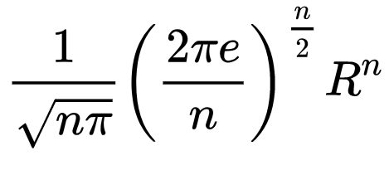
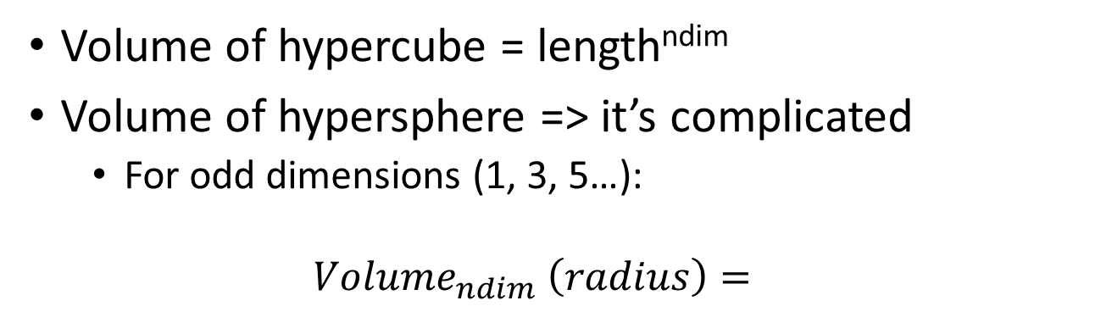
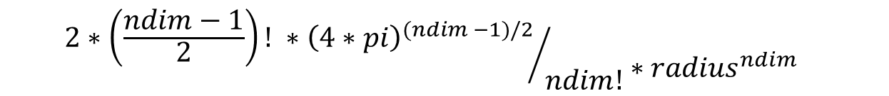
Unintuitive math features
Volume of hypercube = length^{ndim}
Volume of hypersphere => it’s complicated
For odd dimensions (1, 3, 5…):
$${Volume}_{ndim} \left(radius\right)=$$
$${{2∗\left(\frac{ndim−1}{2}\right)! ∗\left(4∗pi\right)}^{(ndim −1)/2}}/{ndim!}∗{radius}^{ndim}$$
Notes:
Explain hypercube

Slide 9
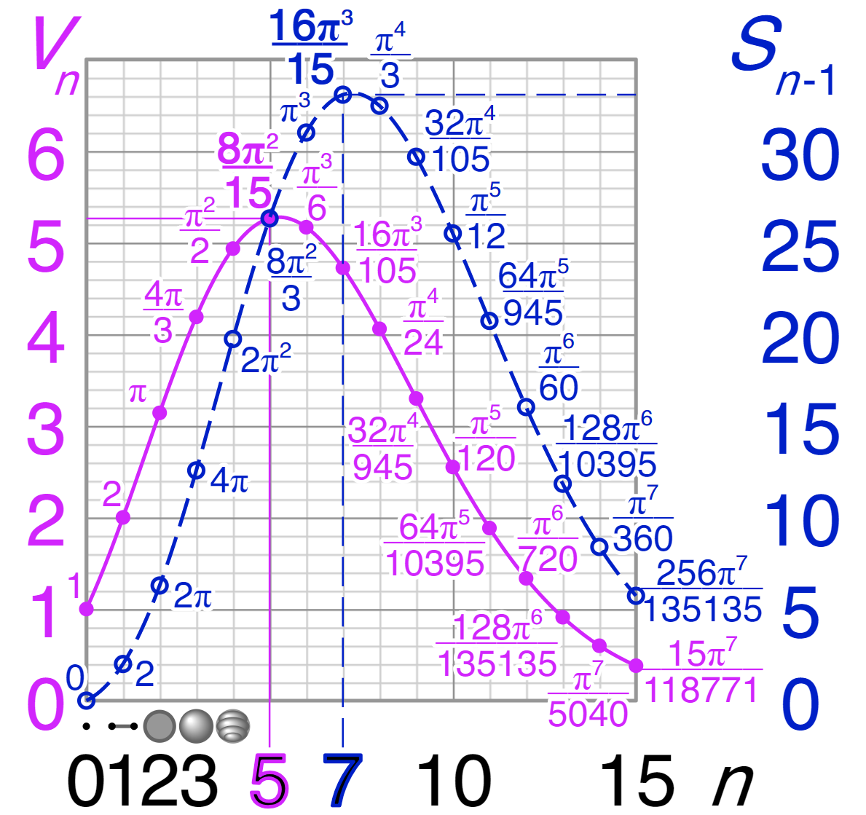
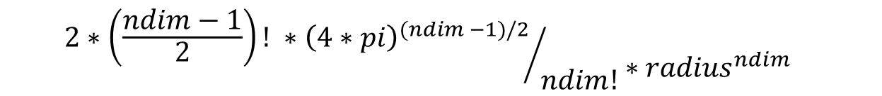
Unintuitive math features
Hypersphere volume decreases with high dimension!
Wikipedia
$${{2∗\left(\frac{ndim−1}{2}\right)! ∗\left(4∗pi\right)}^{(ndim −1)/2}}/{ndim!}∗{radius}^{ndim}$$

Slide 10

Unintuitive math features
It’s not that the radius changes
Volume gets weird
Hypersphere
Hypercube
Volume becomes concentrated in the outer ‘skin’
Because of the ${radius}^{ndim}$ term

Slide 11
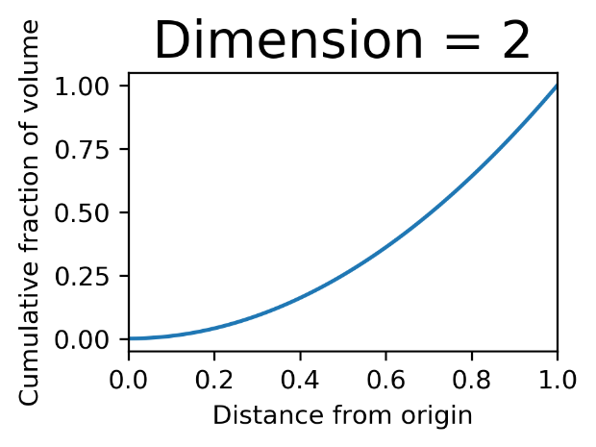
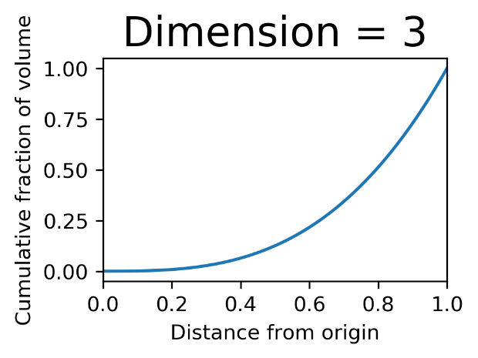
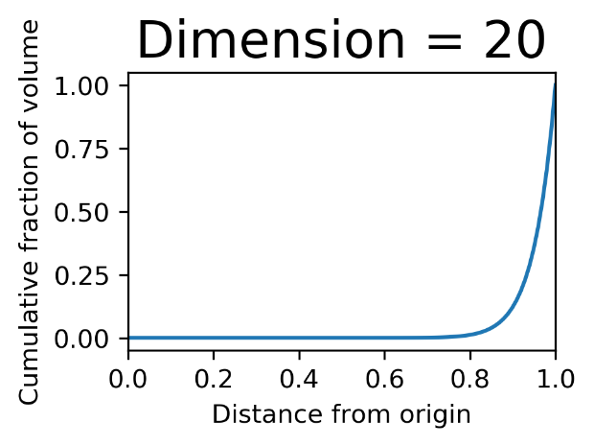
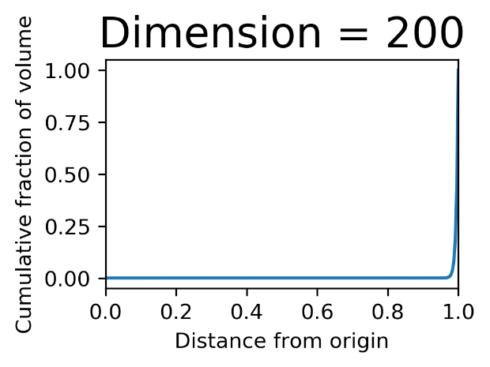
Unintuitive math features
Volume becomes concentrated towards corners and outer ‘skin’

Slide 12
Unintuitive math features
At higher dimensions:
Spheres have little volume
Volume becomes concentrated in the corners and skin
Small changes in radius/length change volume greatly
Practical impact:
Few ‘nearby’ points (using Euclidean distance)
Notes:
Data Mining and Analysis: Fundamental Concepts and Algorithms

Slide 13
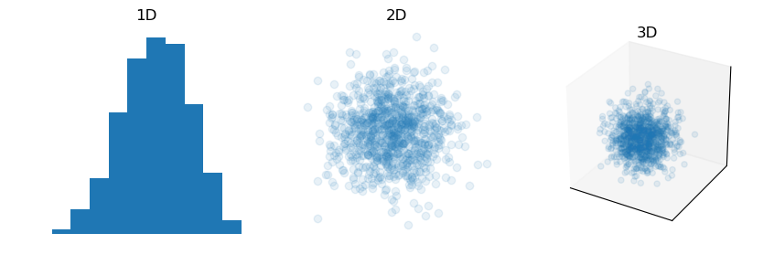
Unintuitive math features
Gaussian/normal distribution in high dimensions?
Density is still always highest at the center
But there’s not much volume in the center
Probability mass becomes concentrated at the skin
Distributions become more ‘bubble’ like

Slide 14
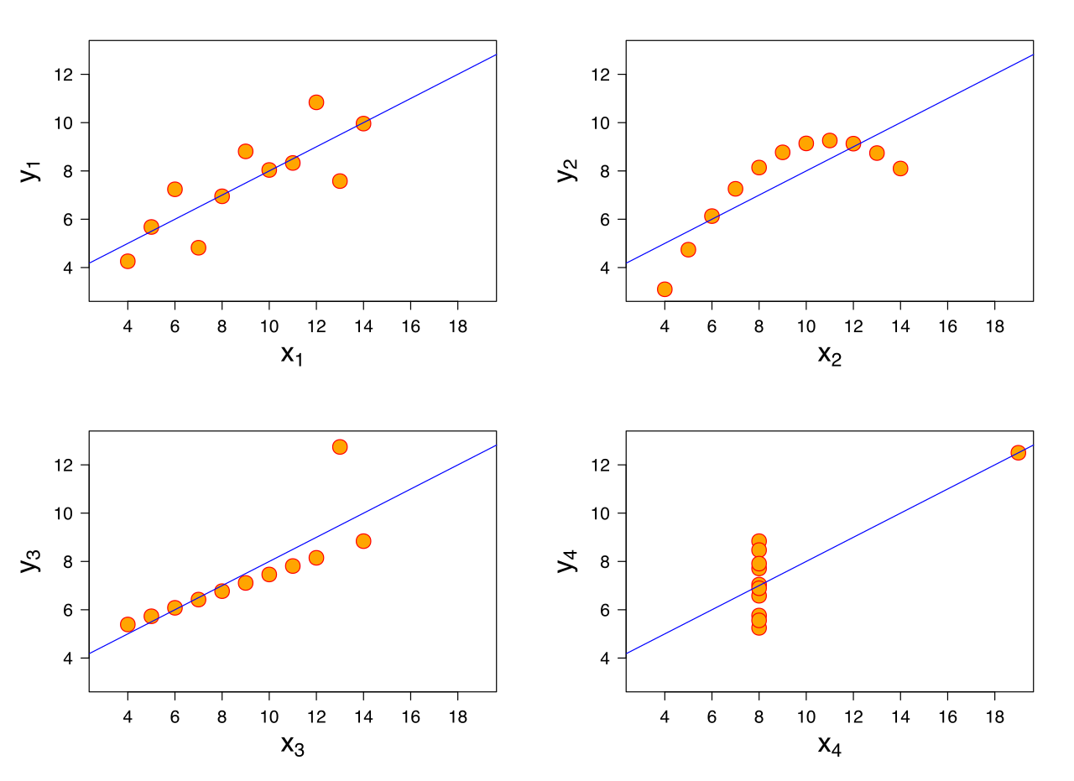
Visualization issues
Why is visualization important?
Wikipedia
All four have same mean and variance!

Slide 15
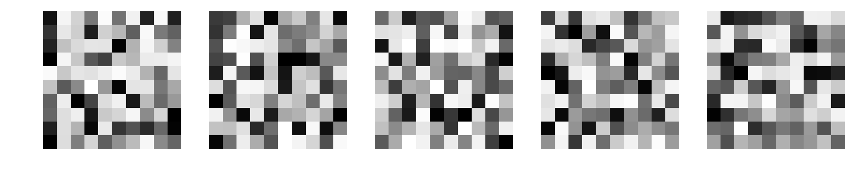

Visualization issues
Why is visualization important?
Mean image (from 1000 samples)

Slide 16
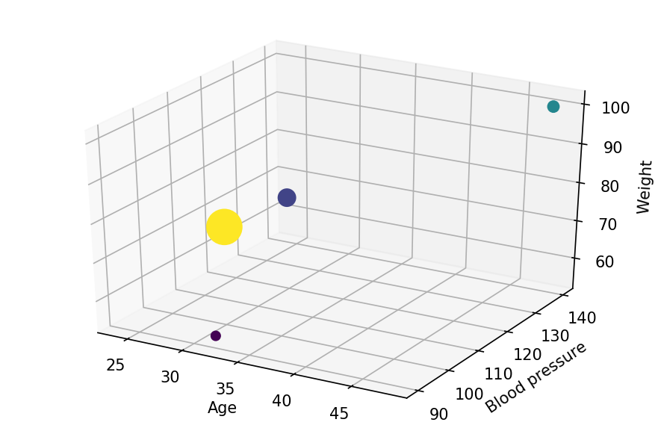
Visualization strategies
‘Overload’ with color, size, and shape
Best for sparse data

Slide 17
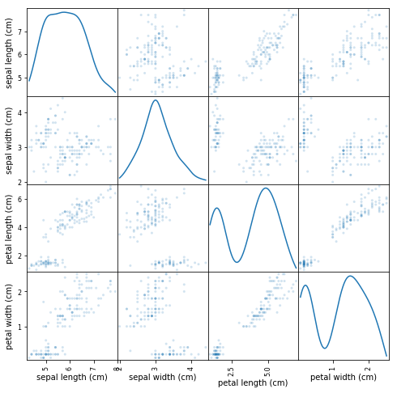
Visualization strategies
Scatter plot matrix
from pandas.plotting import scatter_matrix

Slide 18
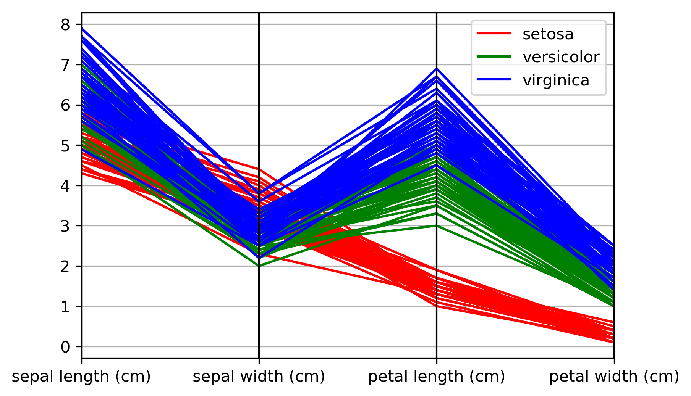
Visualization strategies
Parallel coordinate plot
from pandas.plotting import parallel_coordinates

Slide 19
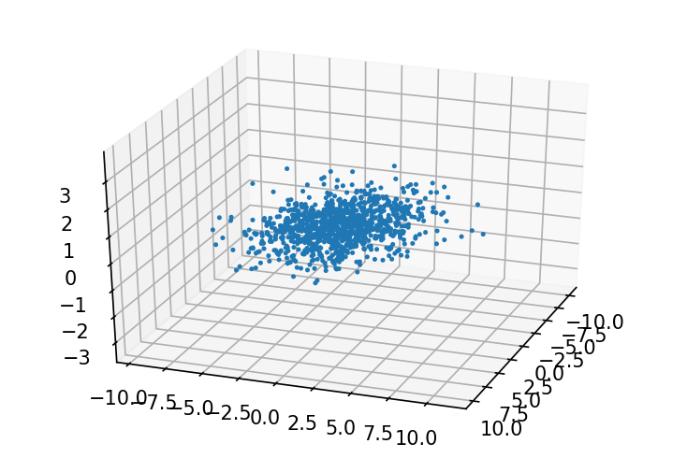
Dimensionality reduction
Why?
Less dimensions can be nicer to work with
Justification:
Often data isn’t fully distributed in it’s n-dimensional space
Equivalently – correlations in the data

Slide 20
PCA – Principal Component Analysis
Isn’t just dimensionality reduction
Can be thought of as:
Capturing covariance
Fitting an ellipsoid to the data
Rotation + scaling
Read up on SVD for details
Eigenvectors of the covariance matrix
Notes:
eigenvectors of covariance matrix

Slide 21
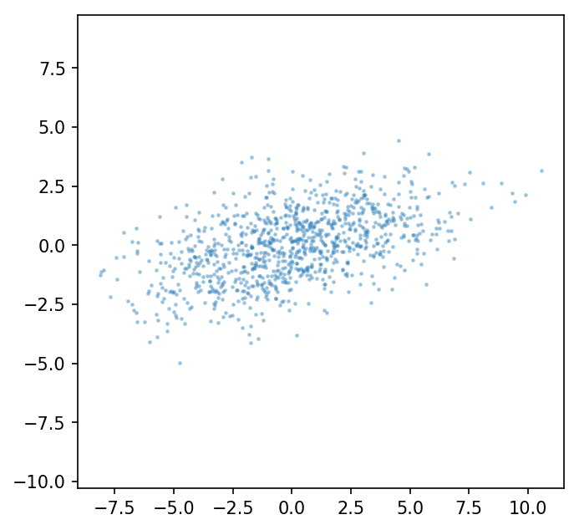
PCA – Principal Component Analysis
Notes:
eigenvectors of covariance matrix

Slide 22
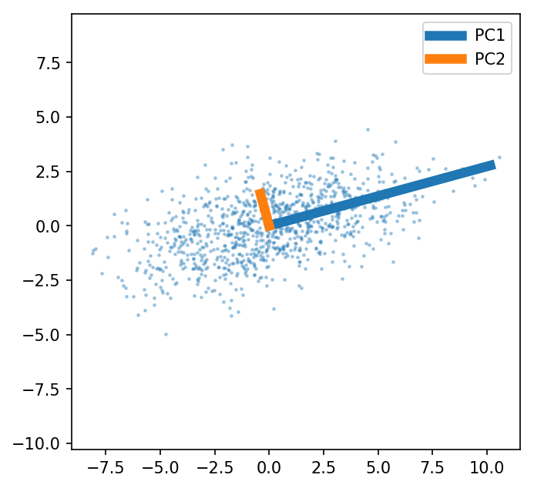
PCA – Principal Component Analysis
Output: Principal Component (PC) vectors
PCs always orthogonal

Slide 23
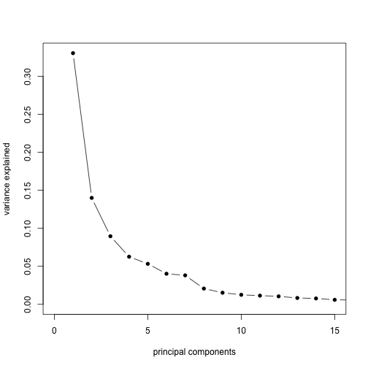
PCA
Dimensionality reduction – truncate # PCs
Explained variance
fraction of total variance explained per component

Slide 24
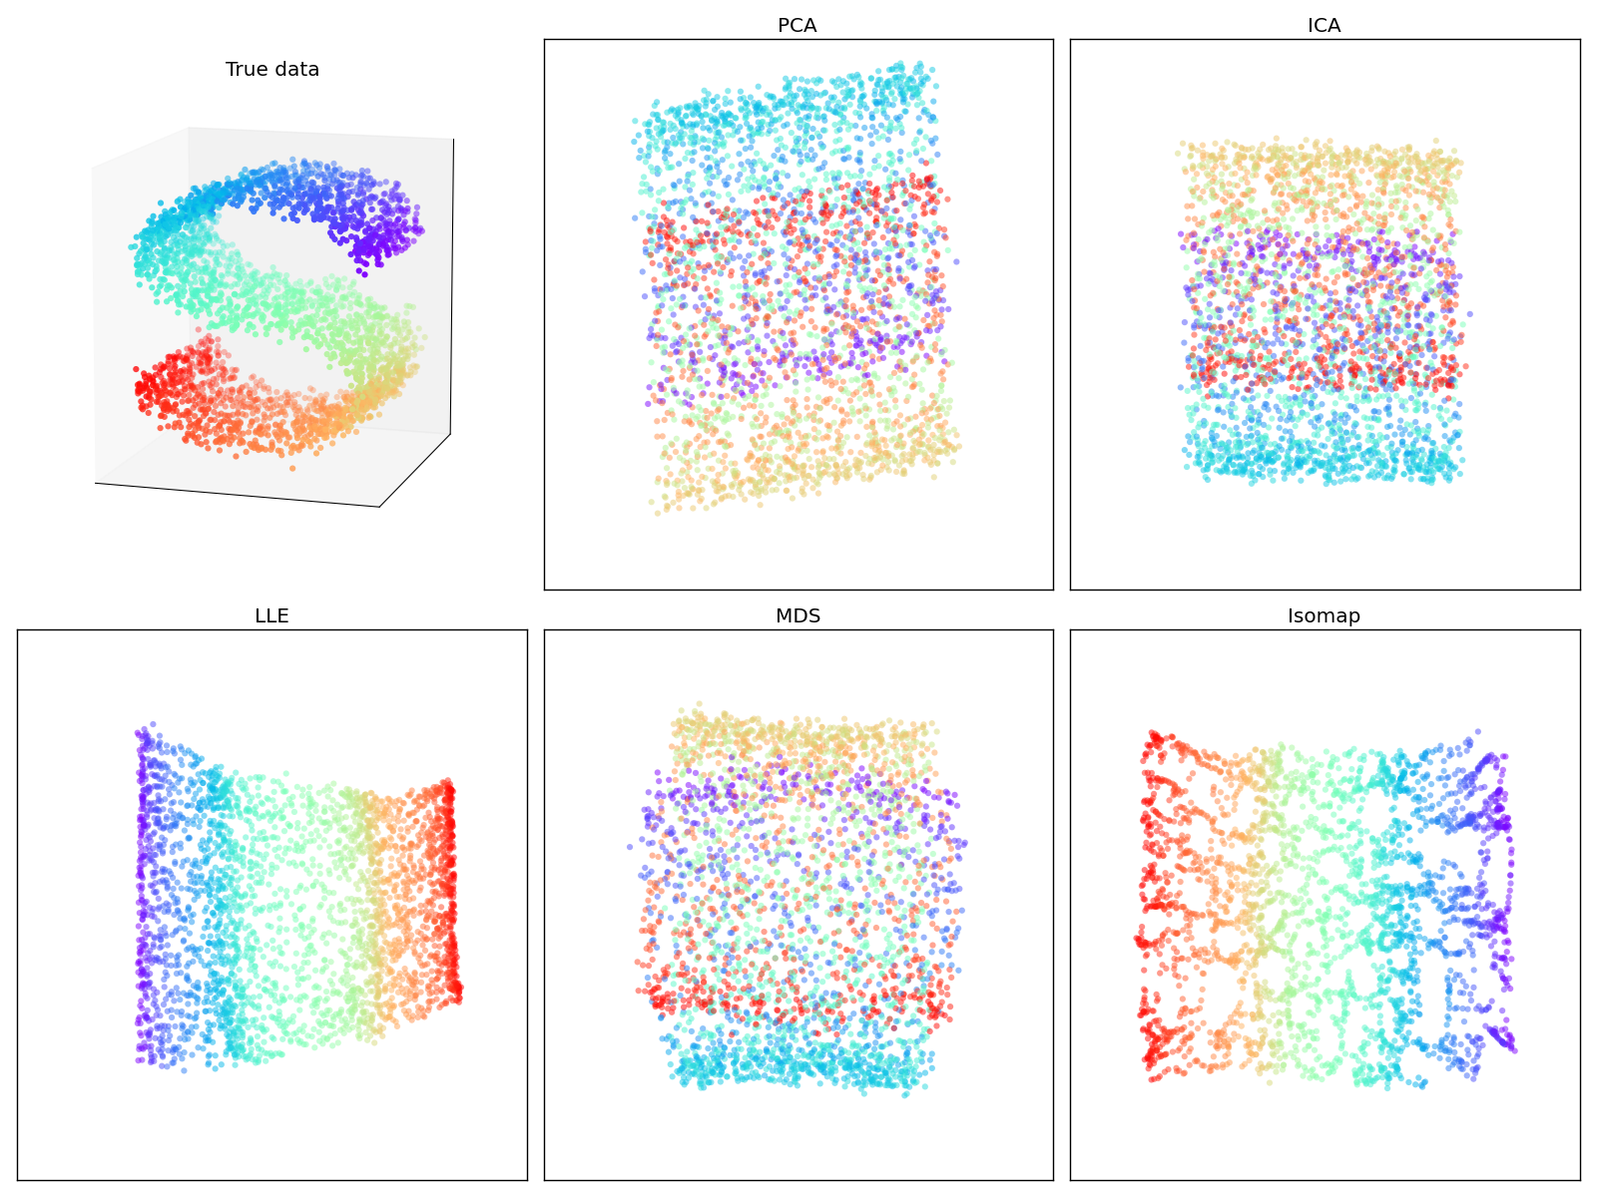
Nonlinear dimensionality reduction
Adapted from sklearn examples

Slide 25
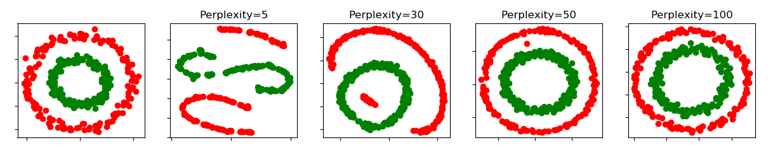
Visualization: t-SNE
t-distributed Stochastic Neighbor Embedding
Tries to preserve local structure
Perplexity” parameter balances local and global
Sklearn
Cluster sizes/shapes not meaningful
Different random seeds can change output!
Not ideal for use beyond visualization

Slide 26
Thanks!
Thanks to JetBrains for hosting/sponsoring
Deeper questions/discussion – come find me later!
Our lab is always looking for programmers and those interested in computation + neuroscience:
joe@neuro.mpg.de

Slide 28
Misc. further references
High dimensional spaces
t-SNE
PCA explained variance

